Slide 1
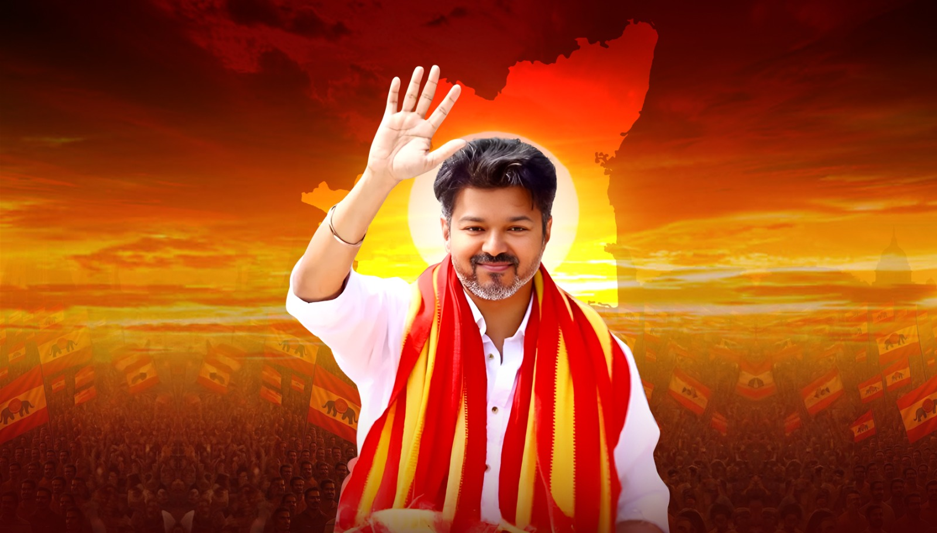
VIRALIMALAI REPORT

Slide 2
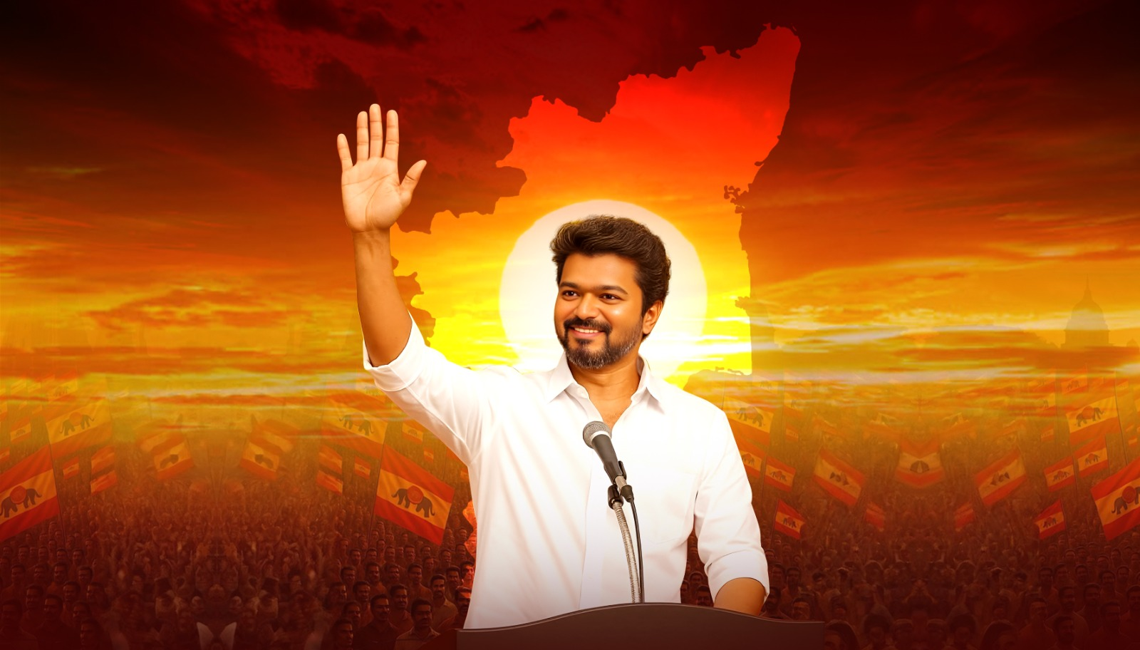
VIRALIMALAI REPORT

Slide 3
Survey Overview – Viralimalai Constituency
A total of 1,024 respondents were surveyed in Viralimalai Assembly Constituency as part of our voter perception study. The sample was carefully designed to reflect a balanced demographic representation, ensuring that the insights derived are credible and actionable.
The survey was administered using stratified sampling, maintaining proper balance in gender (Male: 52%, Female: 48%) and age groups (18–30: 21%, 31–45: 37%, 46–60: 28%, 60+: 15%).
2021 Voting Pattern Control: To prevent party-based sampling bias, we recorded each respondent’s 2021 Assembly Election voting preference. This allows for post-survey normalization and ensures that no political group is disproportionately represented, enhancing the reliability of voter swing and alliance analysis. We have considered this factor for normalization of this data.

Slide 4
Executive Summary
The baseline voter perception survey shows a strong appetite for change and a three-way, winnable contest, with a visible shift toward Vijay (TVK) as the principal alternative. On CM preference, TVK is the main challenger (Vijay 28% vs Stalin 36% vs EPS 26%) and draws across party lines—about 30% of 2021 AIADMK voters, 13% of DMK voters, 37% of ‘Others’, and a dominant 45% of non-voters/first-timers now prefer Vijay as CM.
On winnability perception, the overall belief currently tilts to AIADMK (AIADMK ~36% | DMK ~32% | TVK ~25%), but TVK is within reach in the right segments: 39% of non-voters and 29% of the “Not sure” bloc already think TVK can win. Among voters who want change, belief is AIADMK 42% > TVK 28%—a proof-of-path gap rather than a popularity problem, suggesting a clear turnout- and persuasion-led route to close the distance.
Vijay’s entry is seen as consequential: 55% overall say it will impact 2026—especially AIADMK voters (56%), ‘Others’ (66%), and non-voters (66%)—underscoring TVK’s disruptive potential and greater vulnerability in AIADMK pockets.

Slide 5
Executive Summary
On alliances, a majority (~55%) prefer TVK to contest independently, reflecting strong standalone brand strength, while a meaningful share of other-party voters indicate they would shift if TVK allied—giving TVK leverage to price alliances on its terms without appearing dependent.
Finally, alcohol/drug abuse (~37%) emerges as the #1 public concern, followed by unemployment and law & order—well-suited to a clean, youth-first, de-addiction-centric campaign frame, paired with visible local fixes and strong booth organization to convert preference and impact into victory belief and votes.

Slide 6
CONSTITUENCY OVERVIEW
The top communities are Mutharaiyars 28%, Devendrakula Vellalars 16%, Mukkulathors 13%, Chozhiya Vellalars 10%, Urali Gounders 9%, Muslims 8%, Christians 4%, Others 12%. Rural-heavy seat (85%+), caste coalitions drive outcomes; Kallar (Mukkulathor) influence is high. AIADMK Vijaybaskar looks strong AIADMK won 2011, 2016, 2021; in 2021 Vijayabaskar took 52.83% vs DMK 40.63%, widening the margin to 23k+ votes
AIADMK:
Strong local face (3-term MLA), crisis-time visibility (Gaja, COVID), roads/bus stand/welfare track record
DA case (₹27 cr) lingering in discourse. Probable contender C. Vijayabaskar (incumbent)
DMK:
Statewide brand and active challenger M. Palaniappan raising corruption/EVM issues
However, he hasn't cracked the seat till date. His popularity isn’t a match with the incumbent
Current probable candidate M Palanippan; a change of face is possible after back-to-back losses

Slide 7
CONSTITUENCY OVERVIEW
TVK:
Clean and new alternative space
No active ground structure in the constituency
Should build a clean governance and development narrative
A Mukkulathor (Kallar) candidate can align to the caste math
Major voter issues than can be targeted
Civic basics (roads/water): many interior villages see water once in 4–6 days; uneven road upgrades.
Jobs & agriculture: erratic rainfall + low industry → rising unemployment
Education access: No govt arts & science college; students travel to Trichy.

Slide 8
RECOMMENDATION
Area | Recommendation
Message targeting by caste blocks | Mutharaiyar & Devendrakula Vellalar: jobs/skills + water; Mukkulathor: pride + clean-change; Chozhiya/Urali: roads/market access
Candidate math | A Kallar (Mukkulathor) candidate with clean image might be a good choice to think to match caste structure and contrast the incumbent
Clean-governance frame | Lead with “corruption-free Viralimalai”—contrast against the DA case and promise transparent local spending audits; keep it respectful, fact-led
Booth muscle + youth network | Build booth committees from scratch; absorb disaffected cadres (both sides) and student groups to cover rural pockets

Slide 9
TOP TAKEAWAYS FOR TVK
Close the belief gap vs AIADMK. Flood winnability signals (candidate announcement, booth-committee completion, defections, weekly ground metrics) to shift the change bloc’s winner belief from AIADMK → TVK
Exploit AIADMK leakage. 30% of AIADMK-2021 voters name Vijay for CM, and 56% of them say Vijay’s entry will impact the race—run ward-level conversions and recruit ex-AIADMK booth workers
Own the ‘needs-improvement’ middle. It’s the largest persuasion pool (majority want change); TVK already leads CM preference at 37%—seal with a 5-point local fixes plan (water, roads/drainage, sanitation, safety, jobs/skills)
Consolidate ‘Others’. TVK leads this bloc but it’s split (NTK/DMDK ~11% each). Poach micro-leaders / seat-level understandings to avoid fragmentation
Lead with de-addiction. Make alcohol/drug abuse (36%) your flagship women-and-families plank; pair with youth jobs and law-and-order assurances

Slide 10
VOTE SHIFT AND LOYALTY

Slide 11

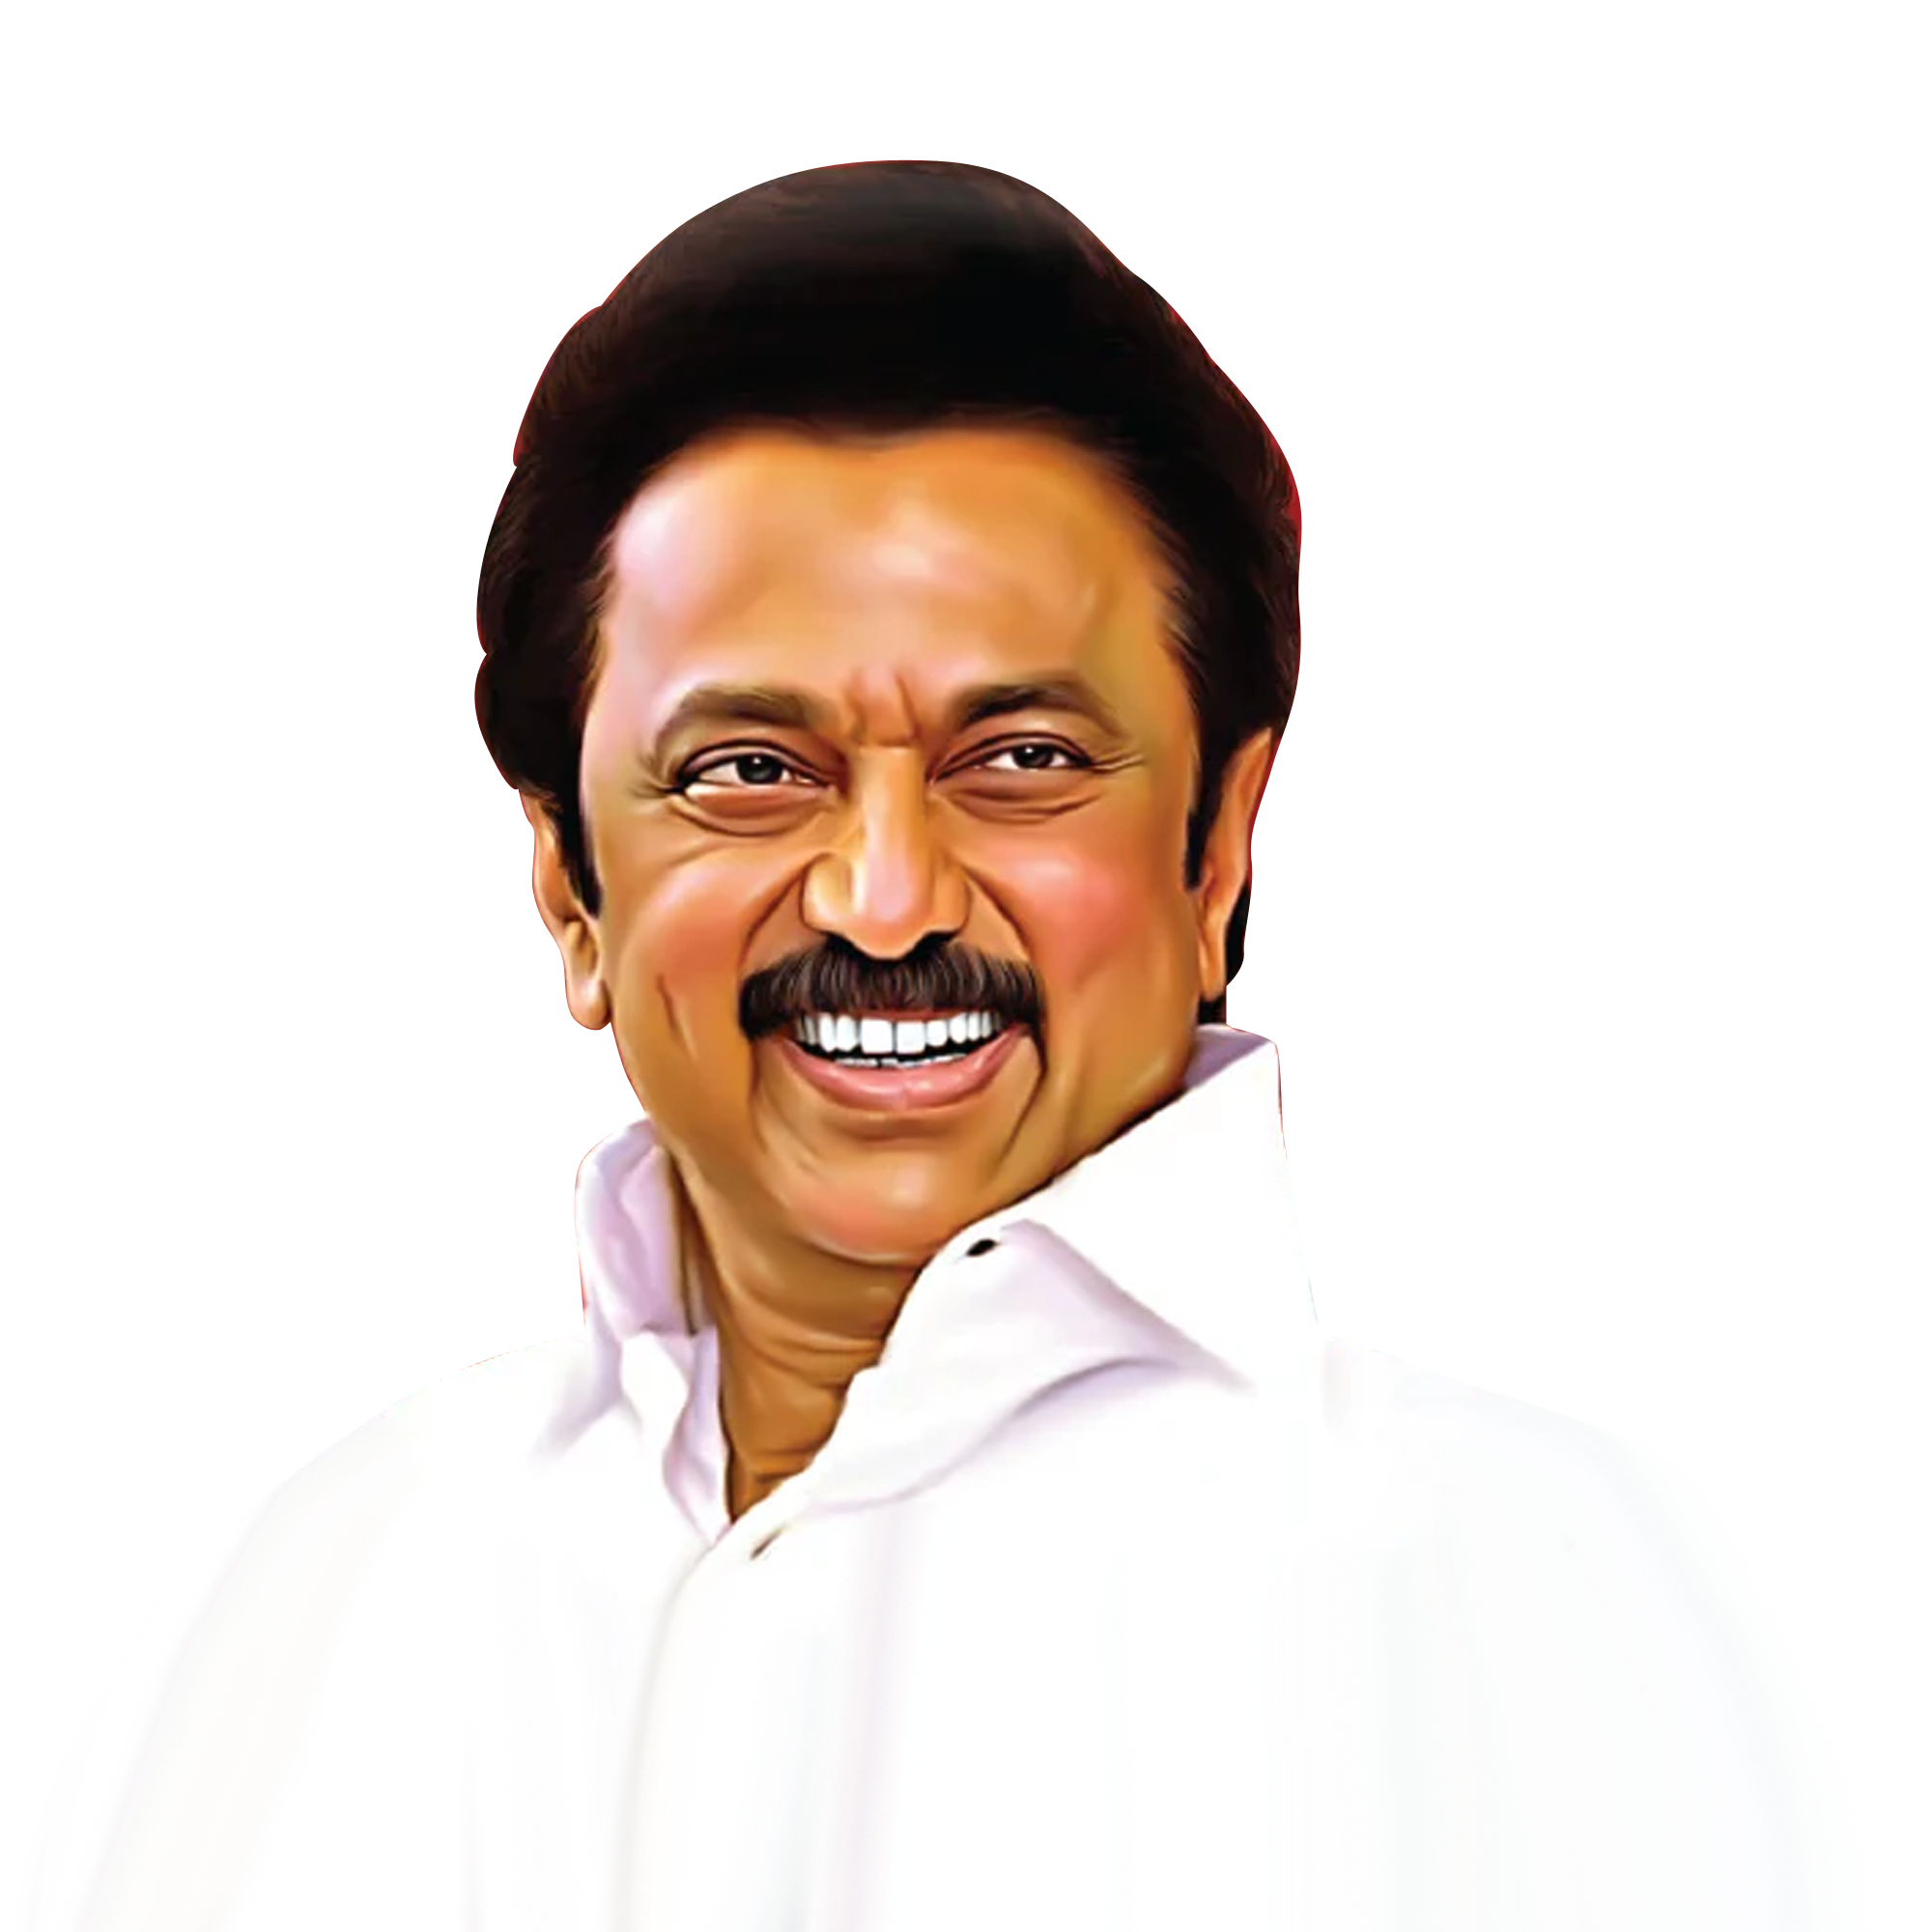
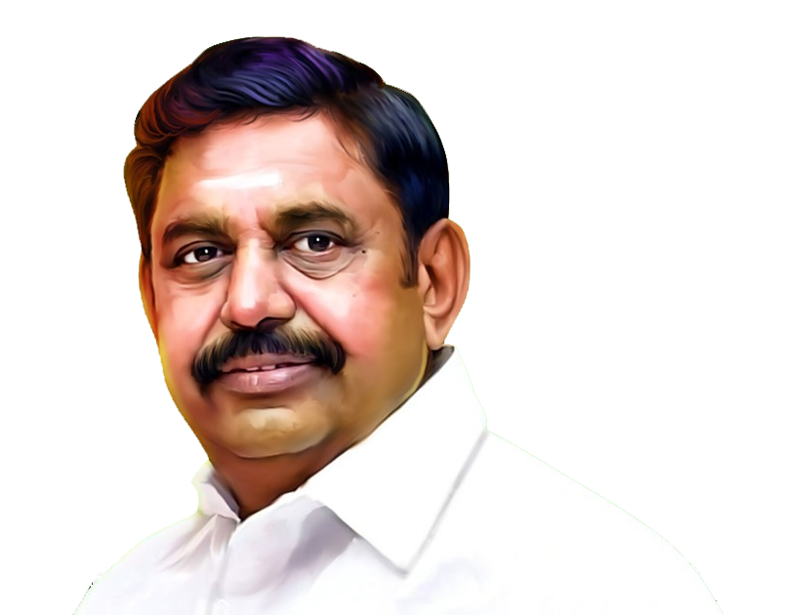
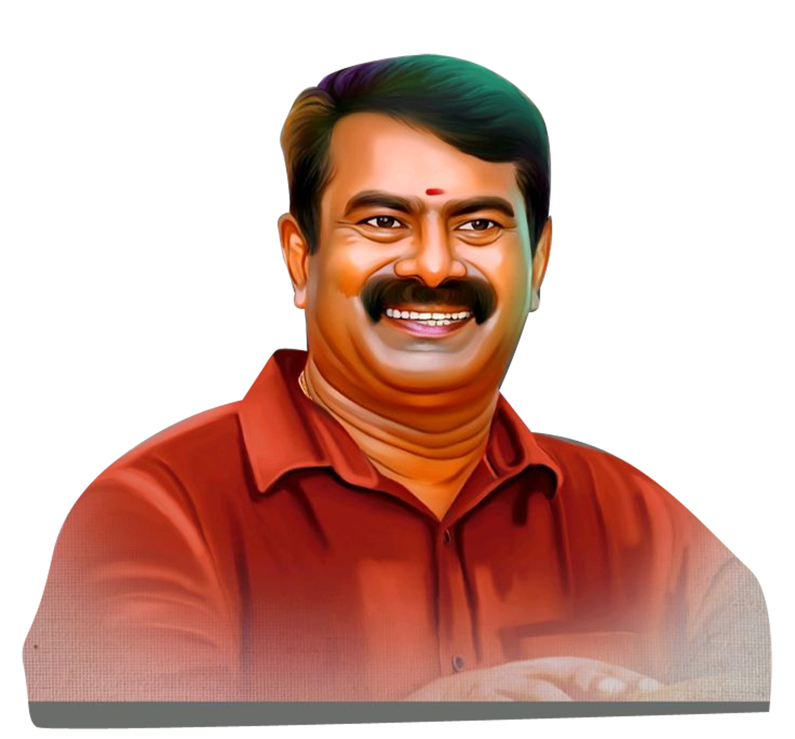
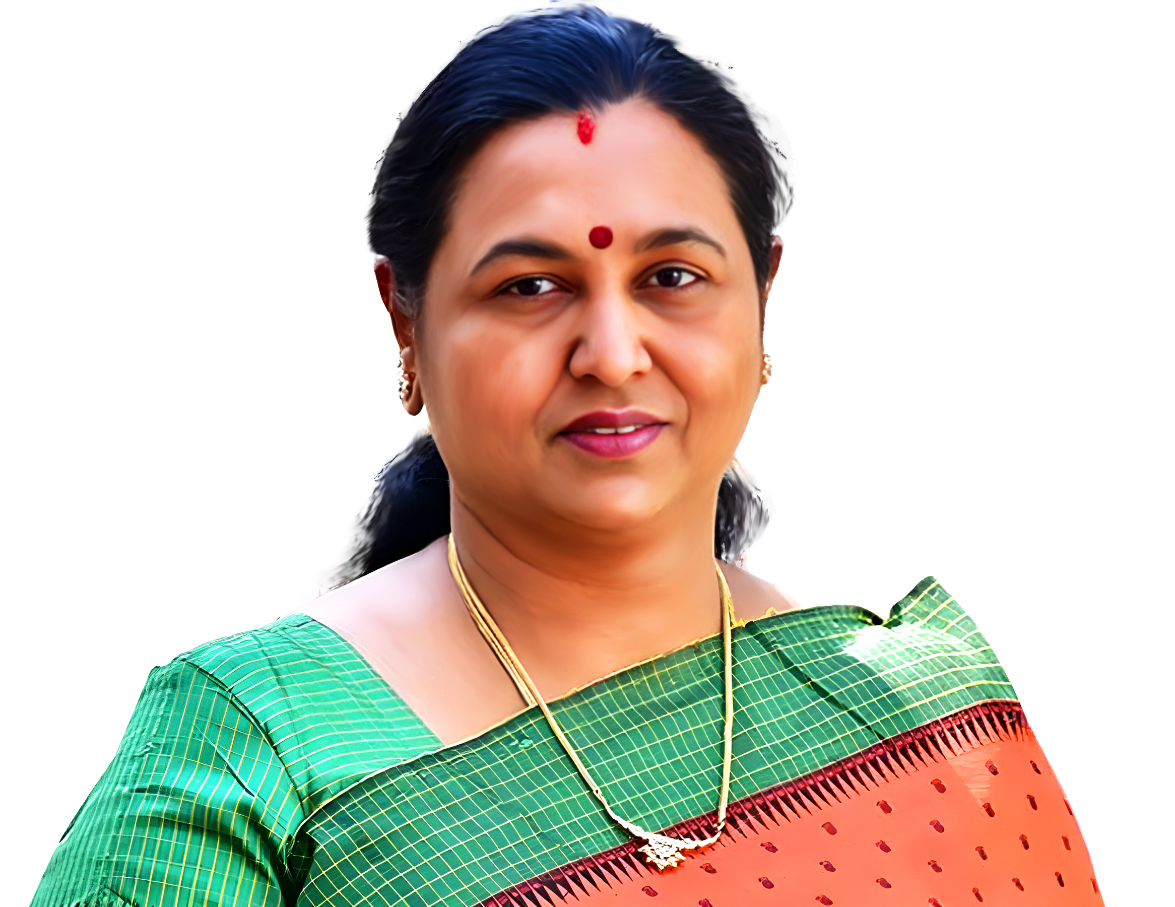
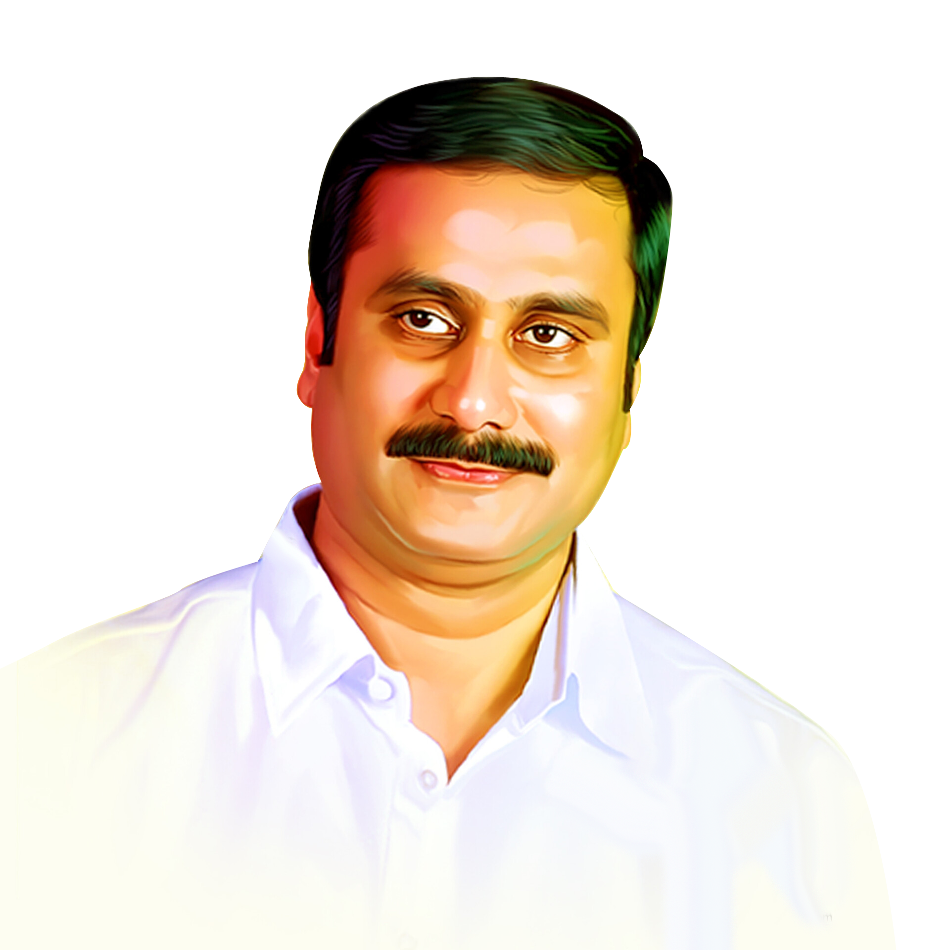

VOTER SHIFT, LOYALTY, AND NEW SUPPORT BASE
2026 CM Choice / 2021 Vote
DMK Alliance | 79% | 3% | 13% | 0% | 0% | 0%
AIADMK Alliance | 6% | 54% | 30% | 3% | 1% | 0%
Others | 13% | 3% | 37% | 11% | 11% | 0%
Did not vote/ Can’t Recall | 36% | 11% | 45% | 5% | 3% | 0%
OVERALL | 36% | 26% | 28% | 3% | 2% | 0%
TVK Take away:
TVK is the main challenger; gap to DMK is 8 pts, over EPS is +2 pts.
Others’ are fragmented—consolidate them: Vijay leads at 37%, but NTK 11% + DMDK 11% create split risk → respectful poaching of NTK/DMDK influencers to avoid fragmentation
Among didn’t vote/Can’t recall, 45% pick Vijay (Stalin 36%, EPS 11%), identify and shift ones supporting DMK
Prioritise AIADMK pockets for conversions as AIADMK leakage is our biggest prize

Slide 12
VOTER REALISM Vs PARTY LOYALTY
2026 PERCEIVED WINNER
2021 VOTE
TVK Take away:
TVK is a competitive third with a small belief gap (~3 pts) vs your CM-preference (~28%). That’s a proof problem, not a popularity problem
Consolidate the ‘Others’ space. Among 2021 Others, belief is TVK 26% but “Others” 51% → risk of fragmentation in the anti-DMK/anti-AIADMK space
Recruit ex-AIADMK booth workers, run targeted contrasts, and show visible local fixes to convert the 29% who already see TVK as the likely winner

Slide 13
VIJAY’s ENTRY IMPACT
TVK IMPACT
2021 VOTE
TVK Take away:
Net-impact index (Yes − No): DMK −14, AIADMK +12, Others +32, Non-voters +32, Overall +10 → impact skew tilts toward AIADMK loss
Consolidate “Others”: respectful poaching of NTK/DMDK micro-leaders so the 66% impact believers translate into TVK vote, not fragmented anti-DMK/AIADMK spill
A majority already believes Vijay will shape this race—especially AIADMK voters, non-voters, and ‘Others’. If we convert AIADMK leak zones and turn out abstainers, Viralimalai might tilt to TVK

Slide 14
ANTI INCUMBENCY AND CHANGE SENTIMENT

Slide 15
ANTI INCUMBENCY AND CHANGE FACTOR
CHANGE NEEDED
Satisfaction on government
TVK Take away:
36% of the people are satisfied with Government performance, while 24% are dissatisfied
Clear change mood: 55% overall want a change. In high-dissatisfaction booths, push winnability signals (candidate strength, booth committees, visible street work) to convert intent → firm vote + turnout.
In the big middle “Needs improvement”, 61% say yes and 24% are unsure → this is your largest persuasion pool

Slide 16
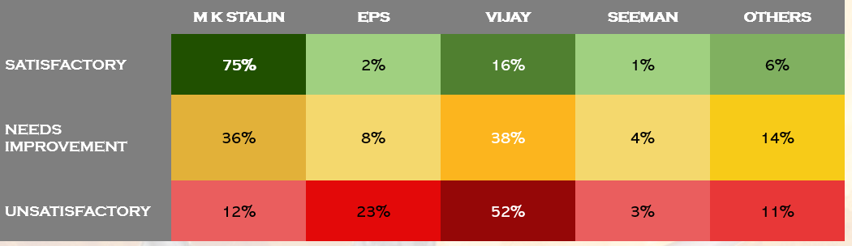
ANTI INCUMBENCY AND CM PREFERENCE
 | M K STALIN | EPS | VIJAY | SEEMAN | OTHERS
SATISFACTORY | 75% | 2% | 16% | 1% | 6%
NEEDS IMPROVEMENT | 36% | 8% | 38% | 4% | 14%
UNSATISFACTORY | 12% | 23% | 52% | 3% | 11%
TVK Take away:
Among “Needs Improvement” voters – Majority 38% want Vijay, only 36% wan Stalin
Among “Unsatisfied” voters- only 12% still support Stalin; most have shifted to Vijay(52%) followed by EPS(23%)
TVK is clearly gaining from soft and hard dissatisfaction
TVK is gaining from soft & hard core anti-DMK sentiment. This is where our campaign should focus- people who are disillusioned with DMK but haven’t fully committed to another party yet

Slide 17
ANTI INCUMBENCY AND CM PREFERENCE
 | M K STALIN | EPS | VIJAY | SEEMAN | OTHERS
SATISFACTORY | 64% | 13% | 18% | 0% | 5%
NEEDS IMPROVEMENT | 25% | 27% | 37% | 2% | 10%
UNSATISFACTORY | 11% | 47% | 28% | 8% | 6%
TVK Take away:
Hard anger skews to AIADMK; soft anger skews to TVK. Intense anti-incumbency currently defaults more to AIADMK
Vijay climbs 18% → 37% → 28% (Satisfied → Needs improvement → Unsatisfied): peak in the middle. EPS climbs 13% → 27% → 47%: strongest in hard-anger pockets.
In “Needs Improvement”, Vijay leads at 37% vs EPS 27% and Stalin 25%. This bloc decides the seat— our biggest conversion pool

Slide 18
ANTI INCUMBENCY & PERCEIVED WINNER
CHANGE NEEDED
TVK Take away:
55% wants a change in government while 24% don’t want and 21% are not sure
Among voters who want change, belief is AIADMK 42% > TVK 28% > DMK 20%. TVK #2 vehicle of change, ~14 pts behind AIADMK—closeable with hard winnability proof.
TVK edges DMK and trails AIADMK by only 7 pts in the not sure block
Viralimalai is winnable if we prove winnability to the change bloc (now leaning AIADMK) and convert the ‘Not sure’ fence-sitters, instead of chasing satisfied DMK voters

Slide 19

TVK TAKE AWAY
The Anti Incumbency Index is 40% (% voters rating DMK as unsatisfactory 24%+ voters wanting change 55%)/2
Swing Conversion Rate for TVK is 28% (% of govt. dissatisfied voters choosing Vijay)
Gap Between Change Sentiment & Belief in change: The perception Gap that TVK must target is 24% (Voters wanting change(20%) + Voters who are not sure(28%))/2, but still believe DMK will win)

Slide 20
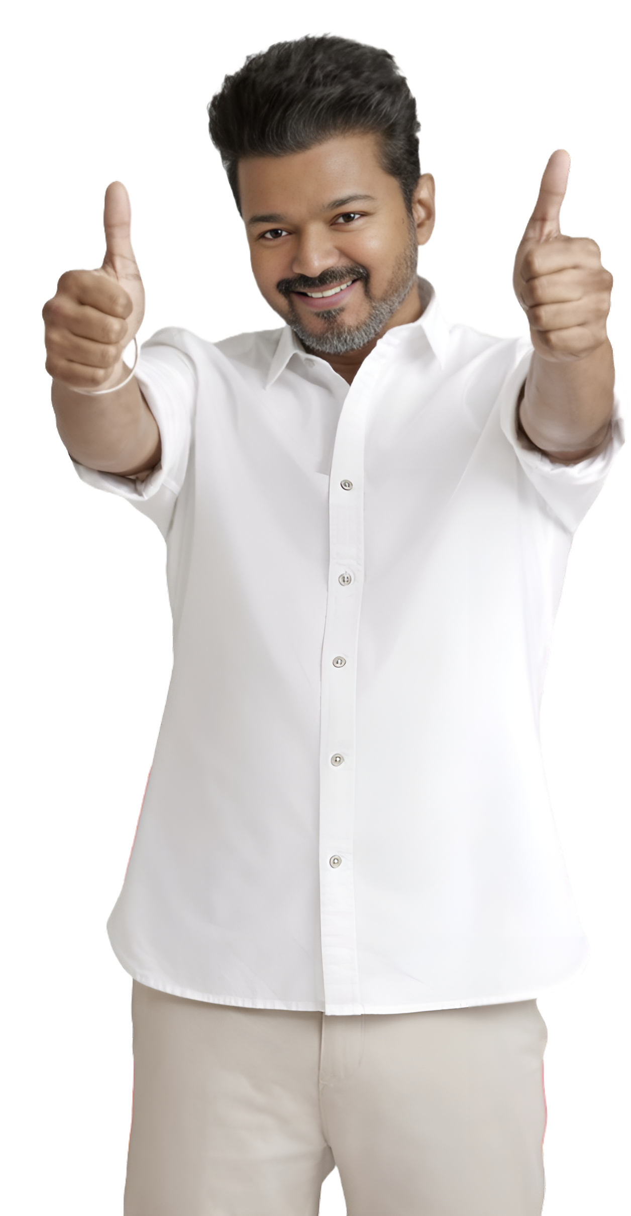
TVK SPECIFIC INSIGHTS

Slide 21
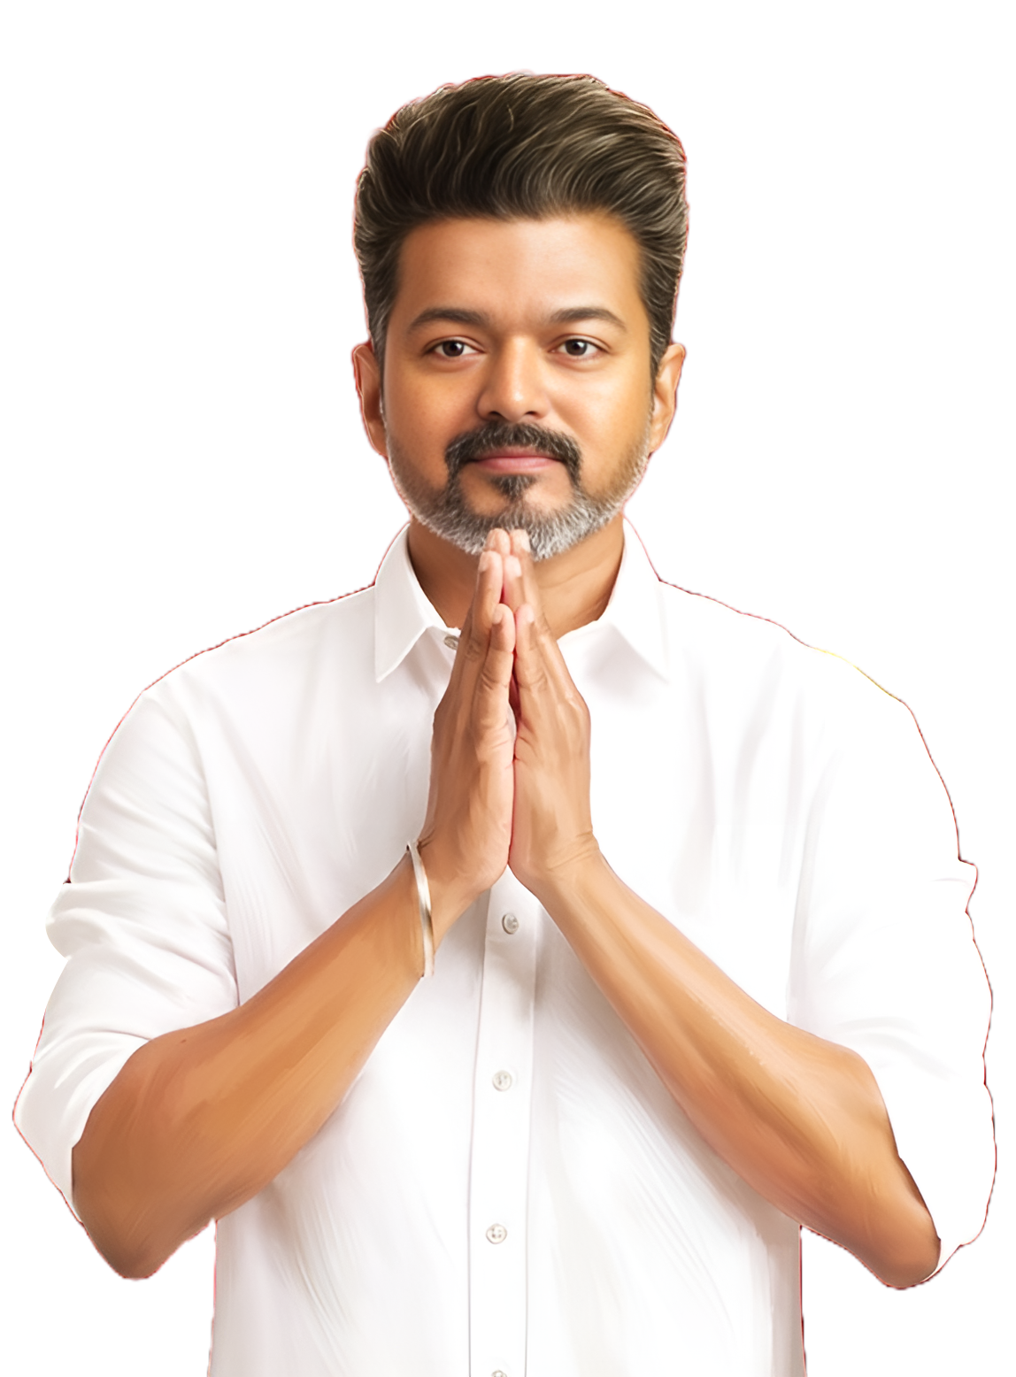
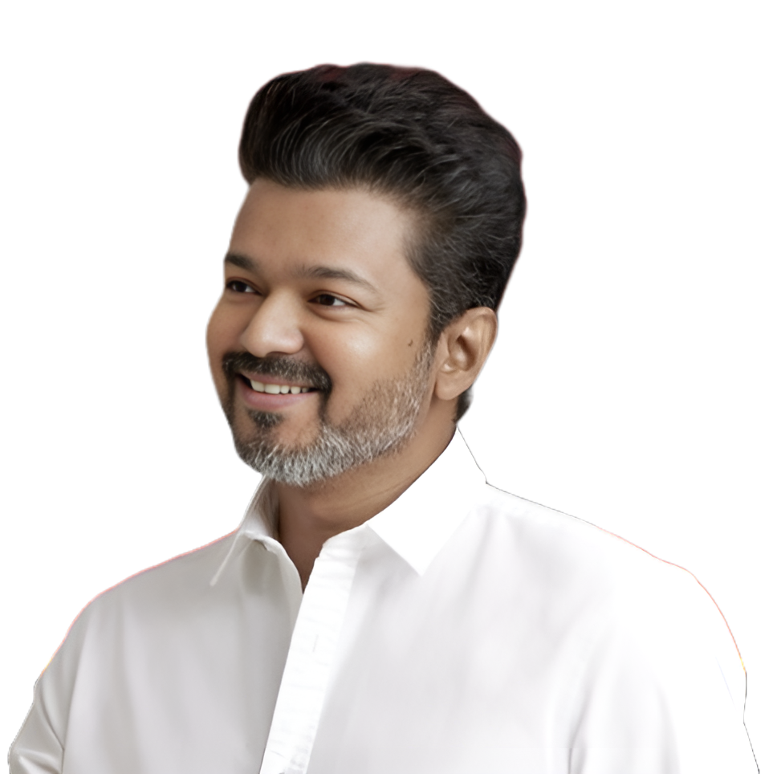

Slide 22
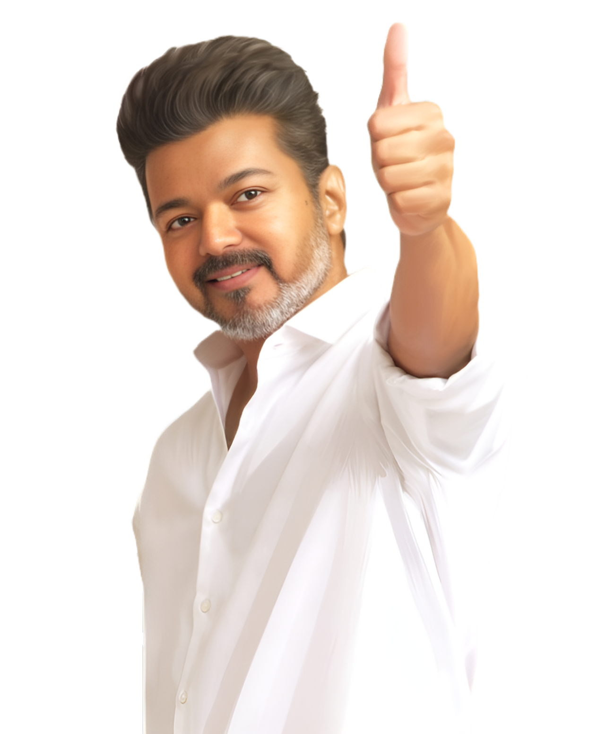
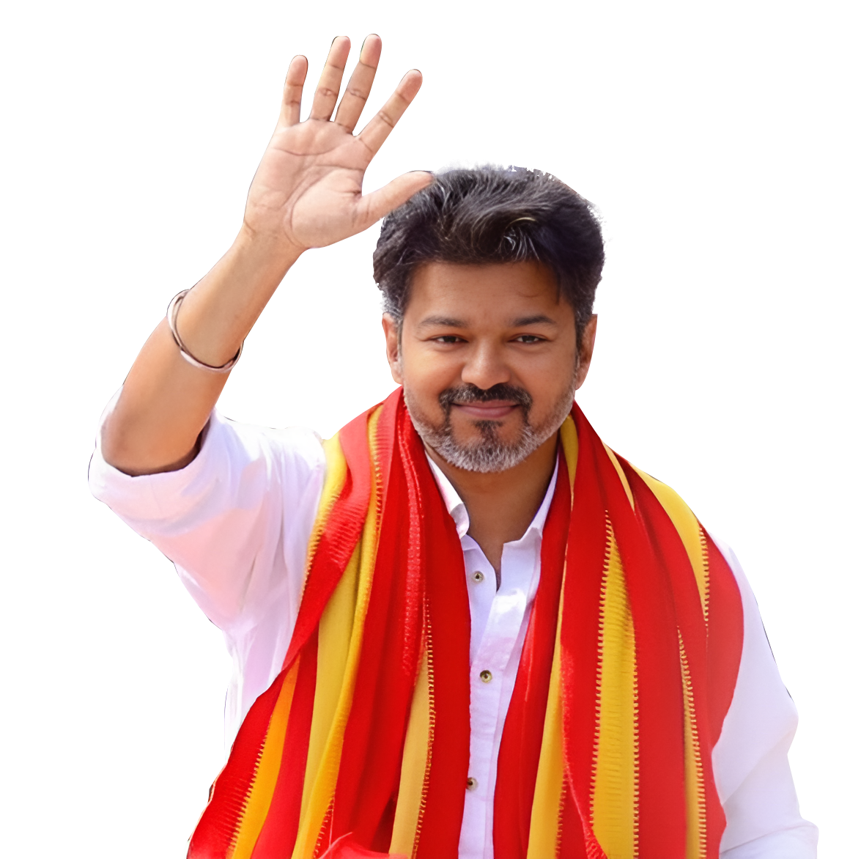

Slide 23
TVK PERFORMANCE RATING
TVK Take away:
67% of voters are Neutral-Positive. This means people are open to your growth(especially the 37% of them who said needs more momentum).

Slide 24
VIJAY’s ROLE IN SOCIAL ISSUES
TVK Take away:
67% of voters notice TVK but expect more(Mainly the 30% who said Inadequate)
While only 33% of them says TVK is irrelevant. Opportunity to scale image

Slide 25
TVK in ALLIANCE- Support/ Shift in Voters
VOTER SHIFT
2026 Party Preferred
TVK Take away:
TVK Vote Catch Potential- 44%

Slide 26
TVK Impact on existing Alliance
People belief on Vijay’s Impact in 2026 Elections
Among Yes, Which Party Alliance will be affected

Slide 27
Preferred Alliance for TVK
TVK Take away:
55% of them wanted TVK to contest independently- this signifies that TVK has good brand strength. However, 22% prefer AIADMK Alliance

Slide 28
CM to Alliance Preference- Ideology Match
ALLIANCE PREFERENCE
CM PREFERENCE
TVK Take away:
Vijay Voters prefer Independence or with AIADMK, while Majority of the AIADMK/EPS supporters want TVK to align with their party. That tells where TVK voters feel most aligned ideologically

Slide 29
PERCEPTION ON EXISTING ALLIANCE BREAKUP
TVK Take away:
37% expect instability in DMK block
38% expect instability in AIADMK block
6 in every 10 voters feel that there are chances that the existing alliances might collapse. This presents a vacuum TVK can fill.

Slide 30
MOST CRITICAL ISSUES PEOPLE ARE FACING

Slide 31
CURRENT WINNABILITY- SNAPSHOT
By Gender
By Age Group

Slide 32
HISTORICAL DATA – VIRALIMALAI
2016
2021
CURRENT SURVEY

